Slide 1
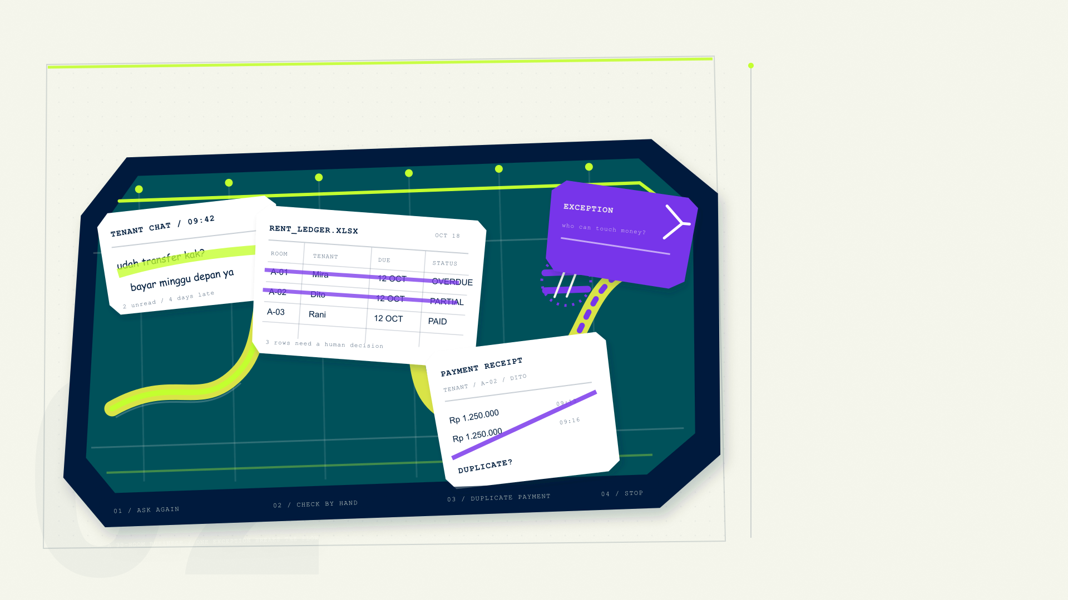
THE PROBLEM
02 / 14
Small businesses
run on chat
and spreadsheets.
Automation breaks on edge cases.
AI agents can’t be trusted with money.
01 LATE PAYMENTS
02 MANUAL MISTAKES
03 RISKY AI ACCESS
THE MANUAL LOOP / 30-ROOM KOS
Notes:
Take a 30-room boarding house. Rent arrives through WhatsApp, gets copied into a spreadsheet, then breaks when a tenant pays partially or twice. The manual loop stops at an exception. AI agents could help, but today they act with broad credentials and no proof.

